Slide 1
Global Agricultural Production and Population Analysis
Project 1
Corey Holton, Elena Gehle, Domenic Guerrero, and Roberta Chandler

Slide 2
Overview
Introduction
Background: This project analyzes global agricultural production relative to population data over time. It uses Python to process data on agricultural production by category, and country, as well as global and continental population data. The goal is to visualize trends and relationships between food production and population growth.
Purpose: Explain the significance of understanding the relationship between agricultural production and population.
Objective: To analyze how global agricultural production has changed relative to population over time, focusing on key agricultural products.
2. Research Questions
Key Questions:
How has the production of major agricultural products (e.g., meat, vegetables, grains) evolved over time?
How does agricultural production vary across different countries and continents?
What trends can be observed in the relationship between agricultural production and population growth?

Slide 3
Data collection, cleanup, and exploration
After deciding on an area of focus a day was spent searching for available dataset for both Agricultural data and World Population data. After we had access to the datasets, we imported them into our notebook and started viewing the data, we quickly realized we had too much data for the agricultural side and were missing many years on the World Population data, so we retrieved another dataset and merged the second with the first to get population by year that matched the Agricultural data set time frame. We dropped a lot of columns that did not pertain to our analysis and did several restructures. Performed several merges so we could focus on production by continents as there were too many countries to plot for graphs. We did the same with items by assigning them to categories that we defined. From there we converted the dataset to time series to plot and do statistical analysis.

Slide 4
Exploration of data
1. Aggregation
Production by Category and Continent: Aggregated production data at different granularities, such as yearly totals by category and continent. Explored averages, maximum, minimum, and sum statistics for different categories.
Top 5 Items by Country: Aggregate the data to identify the top-producing items for a given country (China example in slides).
2. Correlation Analysis
Production vs. Population Growth: Analyzed how the production of food changes with population growth. Used correlation coefficients (Pearson, Spearman) to assess the strength of these relationships.
Category Comparisons: Investigated correlations between different production categories within the same continent, e.g., if meat production increases with grain production.
3. Comparison Analysis
Continent Comparisons: Compare production trends across continents to see which continents have experienced the most growth or decline in specific agricultural categories.
Category Comparisons within Countries: Compared how different agricultural categories contribute to a country’s total production and how these have changed over time.
4. Summary Statistics
Yearly Production Summaries: Calculate mean, median, standard deviation, and quartiles for production data by category, to identify trends and anomalies.
5. Sentiment Analysis
Public Perception of Agriculture: We could see a fall in Europe’s agricultural production which makes since given the negative perception farmers impose to the environment in Europe have received over the past decade.
6. Time Series Analysis
Forecasting Production Trends: Utilize time series analysis with Prophet to forecast future production levels for specific categories, continents, or countries (if we have time)
Population vs. Production Over Time: Time series was plotted to show population vs agricultural production on a global scale to see how the trends interact over time. This data could be used to predict the future of both population growth and agricultural supply for the future, although it does lack the availability of predicting yields and available farmland.

Slide 5
Approach to achieving project goals
Stay on task, be diligent and make progress daily until the tasks were finished
Task were outlined in detail so that we knew what had to be done
To answer our questions, we started by preparing the data so that we could do the analysis. Once the datasets were prepared, we started making different graphs based on the questions we had. Some observations aroused our curiosity and led us to do further exploration of the data.
The next goal was to work on the readme file which was assembled in short time
Lastly, we made an outline of the presentation and added necessary graphs so that would help guide us to complete this portion of the task

Slide 6
Additional questions, what share a plan for future development.
Upon reviewing the data we observed many things that we did not expect, 1st is that North America is a relatively small producer compared to most other continents. We noticed that Europe has a decline in food production. Another surprise is that Chickens are the most produced animal in almost every country. We observed that the US has a major decline in honey production, our initial thoughts are that it has something to do with the introduction of processed sugars. As this appears to be a US only problem from the few countries we observed manually. A future project may be to look at honey production by country and see if this is a global or just a US trend.

Slide 7
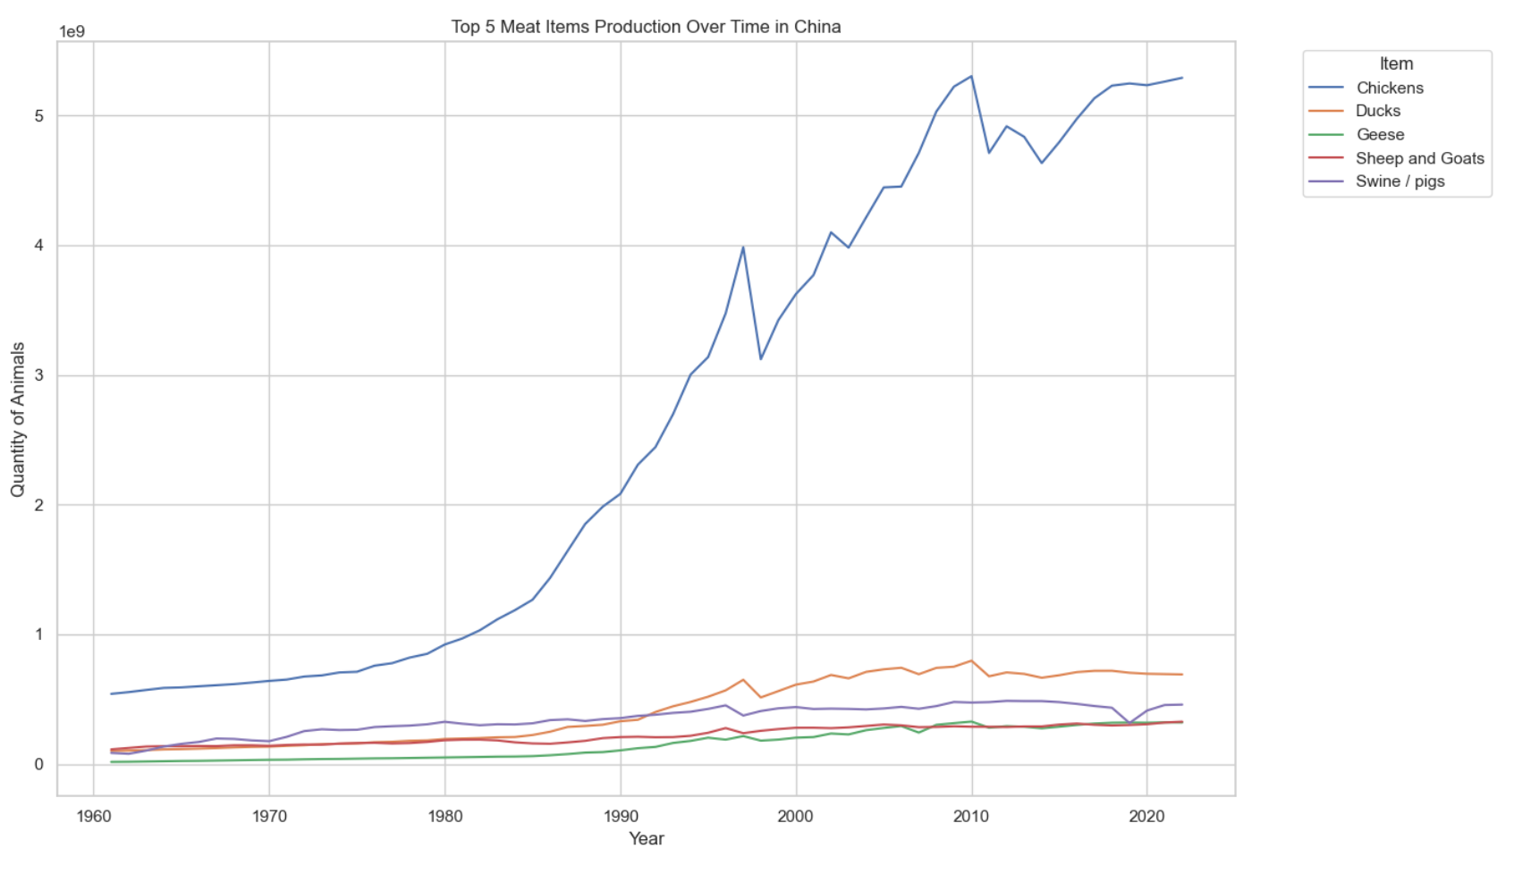
Interesting, chicken is the most produced animal in every continent and almost every country

Slide 8
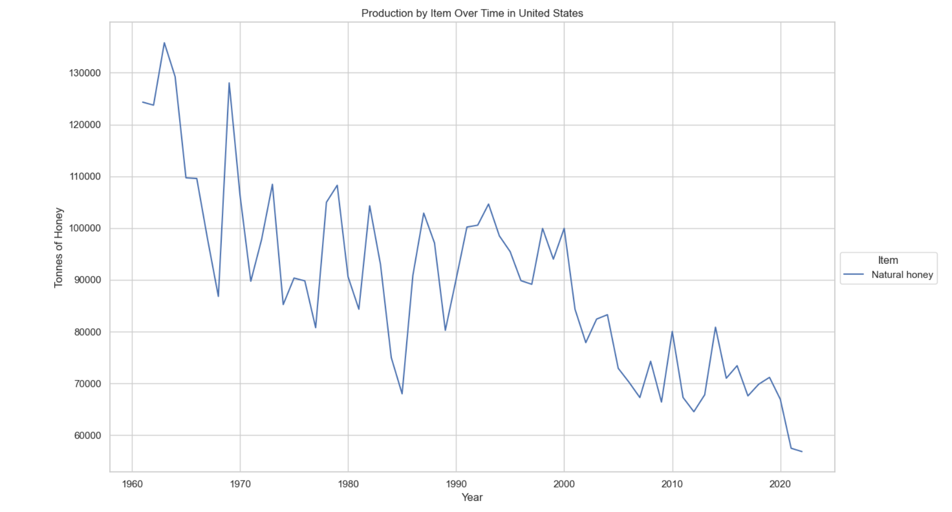
Honey production in the US

Slide 9
Analysis and Conclusion
Findings are strongly supported with numbers and visualizations (10 points).
Write-up summarizes major findings and implications at a professional level (10 points).
Each question in the project proposal is answered with precise descriptions and findings (5 points).
Each question response is supported with a well-discerned statistical analysis from lessons, such as aggregation, correlation, comparison, summary statistics, sentiment analysis, and time series analysis (5 points).

Slide 10
Visualizations
6–8 visualizations of data (at least two per question) (10 points).
Clear and accurate labeling of images (5 points).
Visualizations supported with ample and precise explanation (5 points).

Slide 11
Presentation Requirements
Your presentation should cover the following:
An executive summary or overview of the project and project goals (5 points).
An overview of the data collection, cleanup, and exploration processes (5 points).
The approach that your group took in achieving the project goals (5 points).
Any additional questions that surfaced, what your group might research next if more time was available or share a plan for future development (5 points).
The results and conclusions of the application or analysis (5 points).
Slides effectively demonstrate the project (3 points).
Slides are visually clean and professional (2 points).

Slide 12
How has the production of major agricultural products (e.g., meat, vegetables, grains) evolved over time?
Technology
Plant varieties
Planting
Practice
Risk Management
Data Management
https://www.usda.gov
https://www.farmprogress.com
https://www.brunel.net

Slide 13
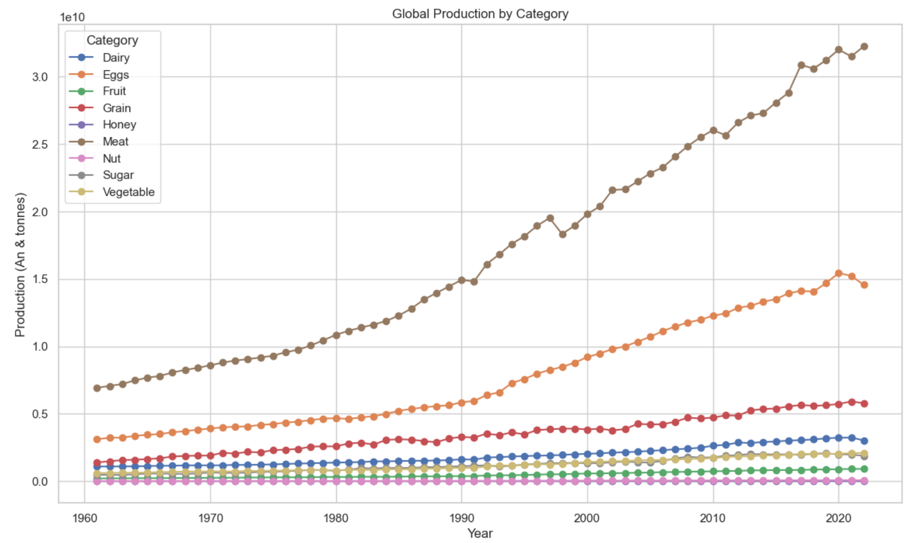
Graph of Global Production by Category

Slide 14
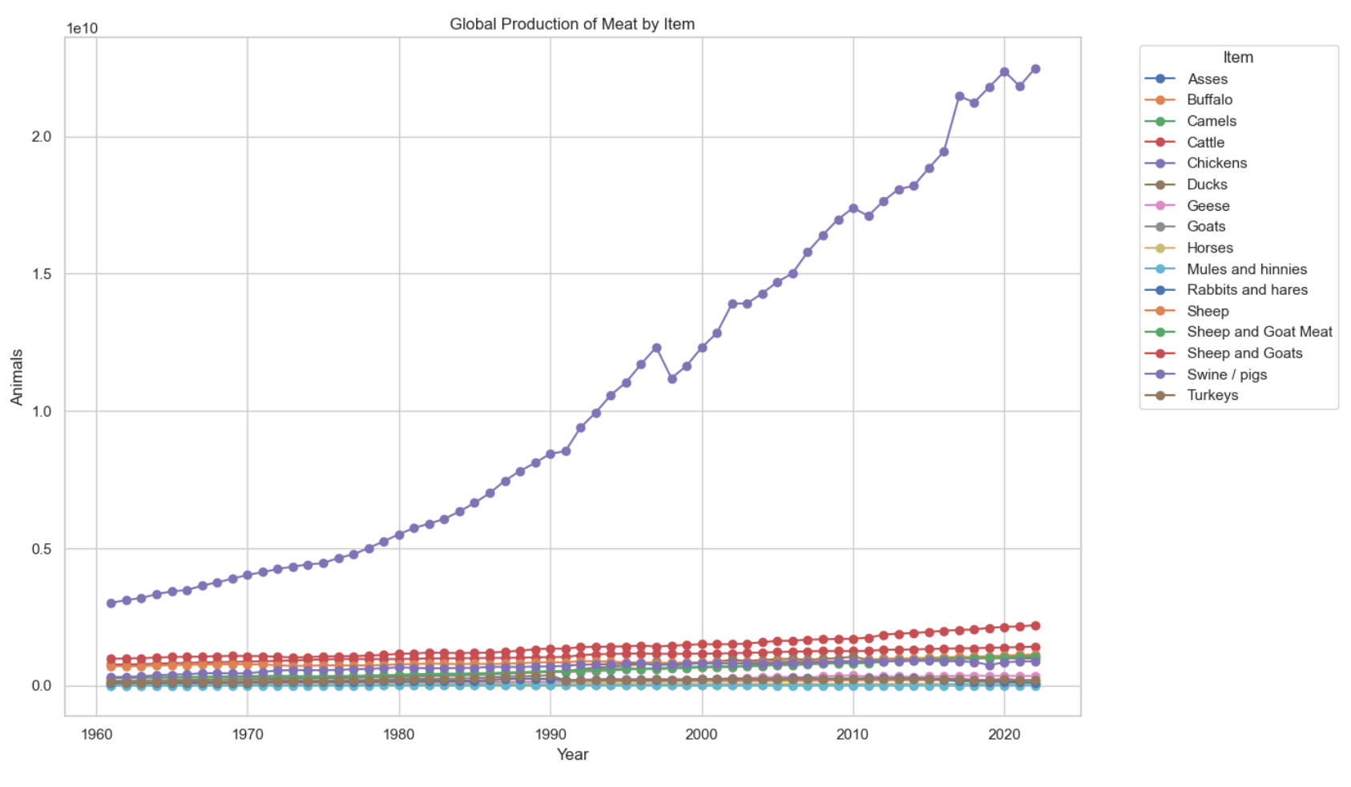
Graph of Global Meat Production by Item

Slide 15
How does agricultural production vary across different countries and continents?
Domenic Will ANswer this one
Geography
Politics and Economics
https://www.nature.com
https://voxdev.org
https://agclassroom.org

Slide 16
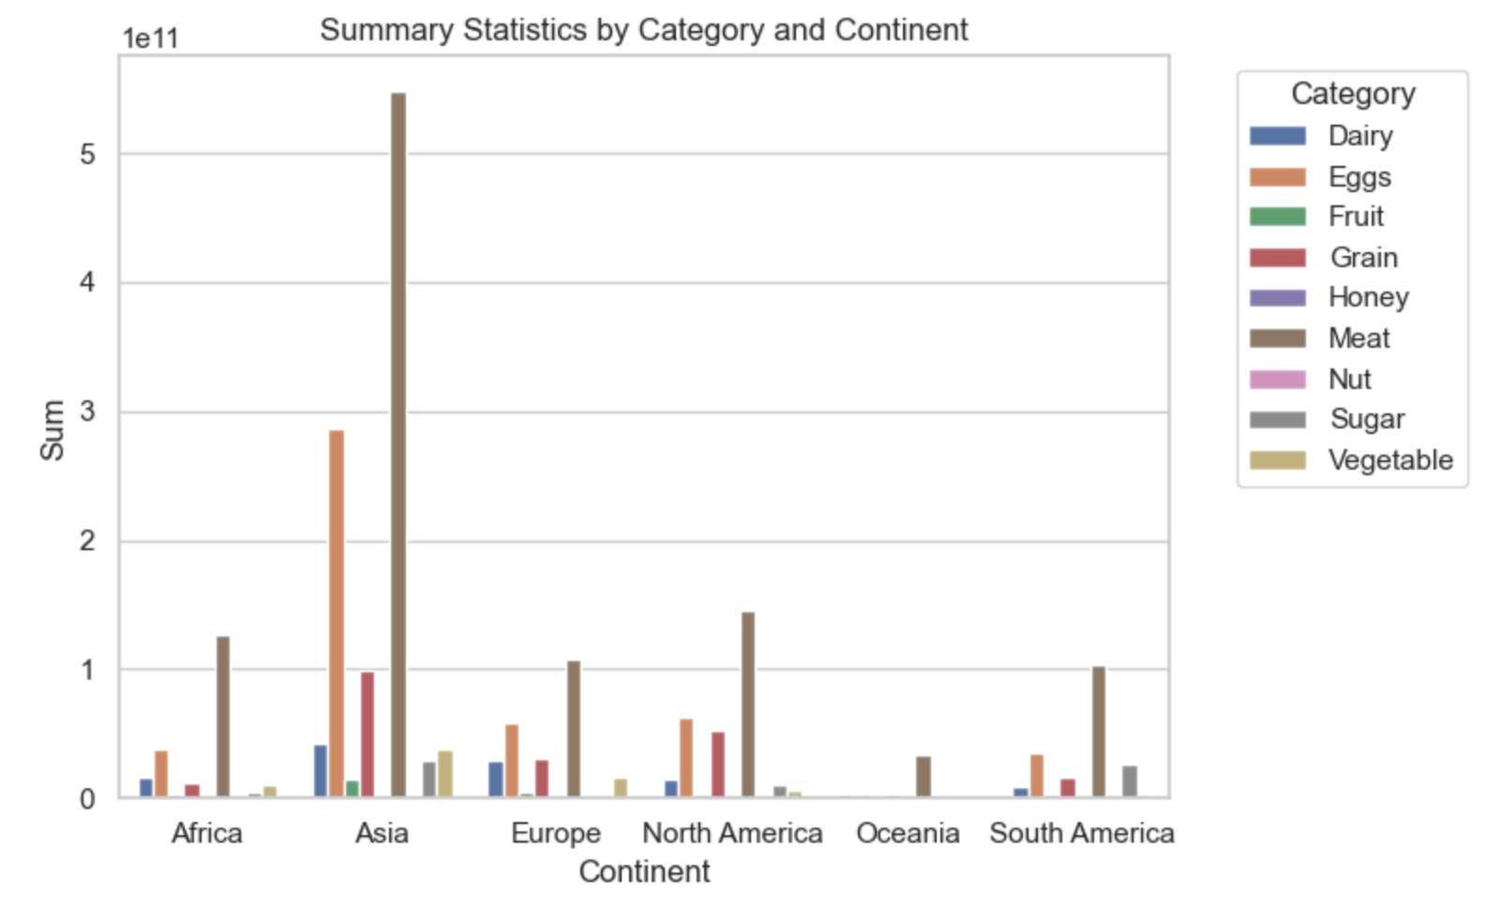
Production of category by continent (sum)

Slide 17
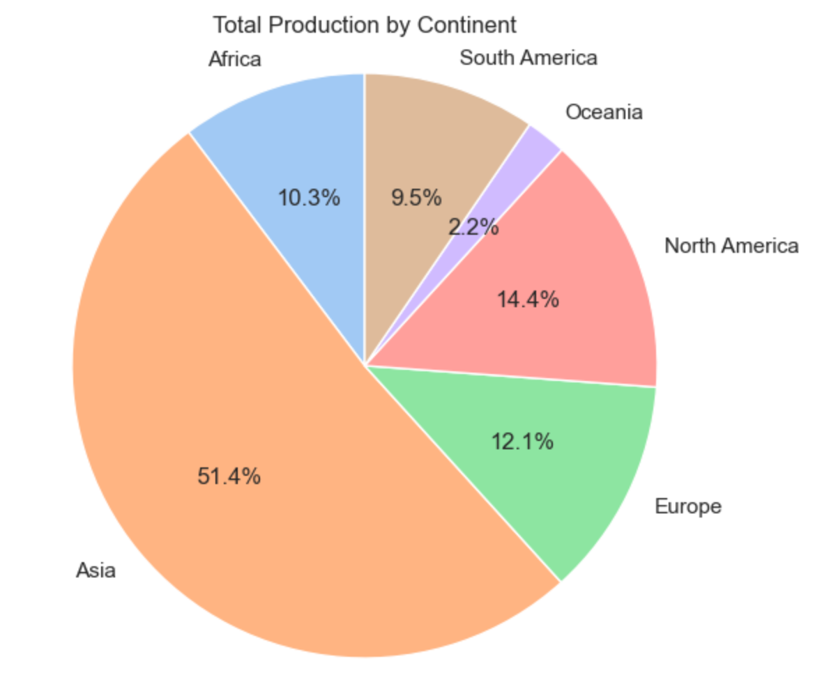
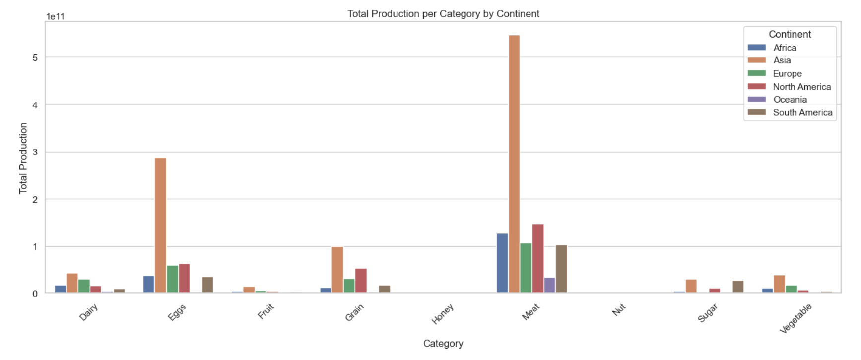
Sum of sums
sum

Slide 18
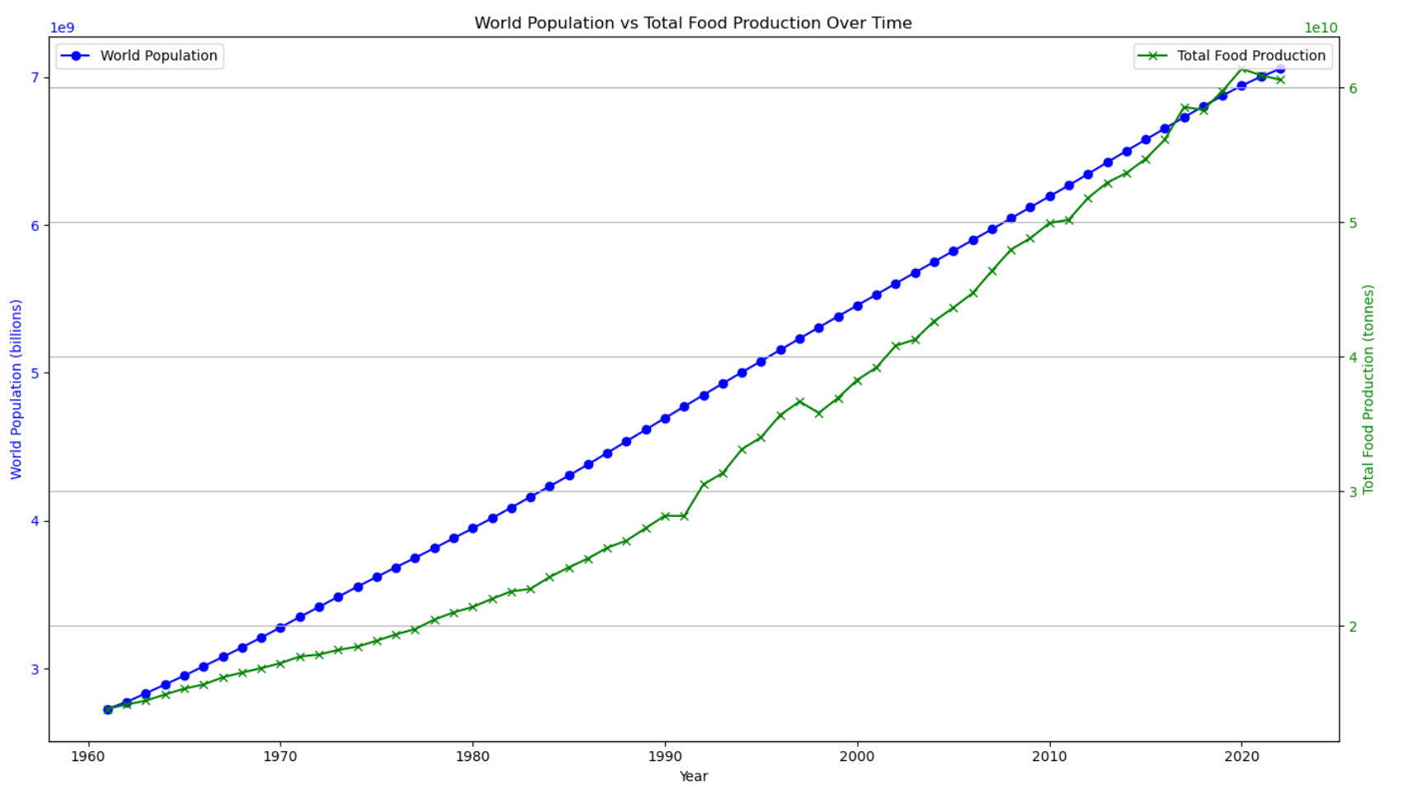
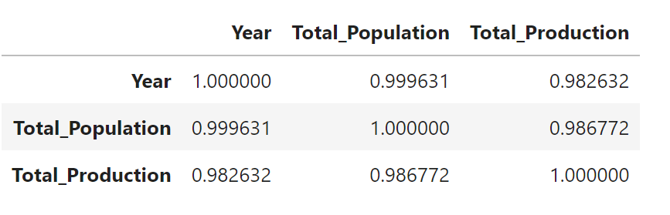
What trends can be observed in the relationship between agricultural production and population growth?
Upon reviewing the data a strong linear relationship was observed in the data between agricultural production and population growth. Population growth from the 1960’s till current has been at almost a constant growth, this is a bias in our dataset as world population pre-1960 was much flatter and future predictions expect population growth to decline. Agricultural production started in the 1960’s with an almost 1:1 with population but lagged until 2017 when it surpassed population then abruptly declined to pace with population demands as observed on the graph.
Pearson correlation coefficient: 0.9867722599767363
Spearman correlation coefficient: 0.9996474528468182

Slide 19
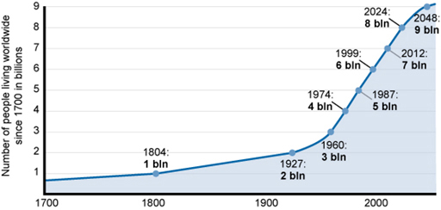
World Population vs Total Food Production

Slide 20
Conclusion
Findings are strongly supported with numbers and visualizations (10 points).
Write-up summarizes major findings and implications at a professional level (10 points).
Each question in the project proposal is answered with precise descriptions and findings (5 points).
Each question response is supported with a well-discerned statistical analysis from lessons, such as aggregation, correlation, comparison, summary statistics, sentiment analysis, and time series analysis (5 points).

Slide 21
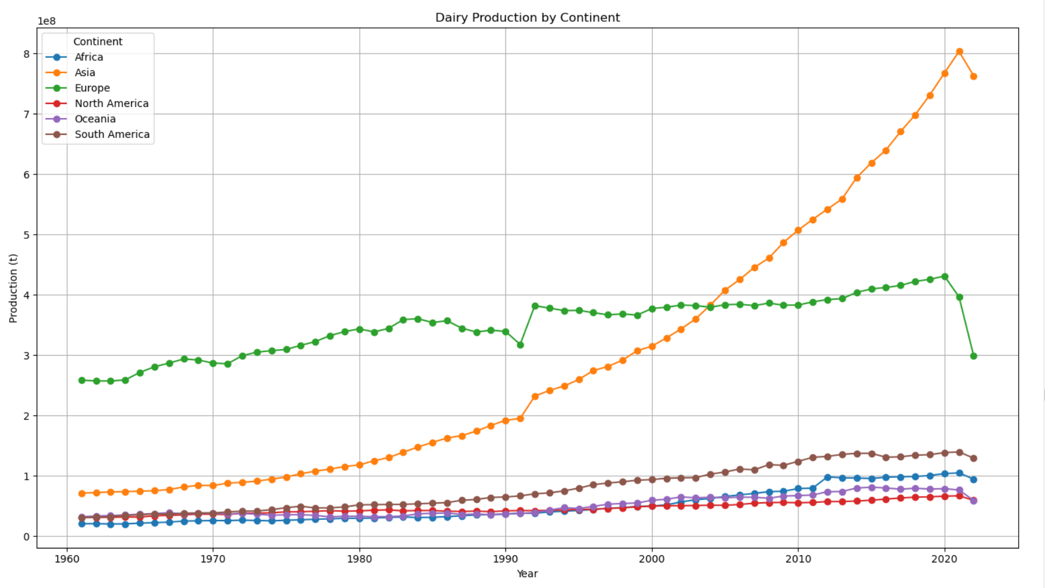
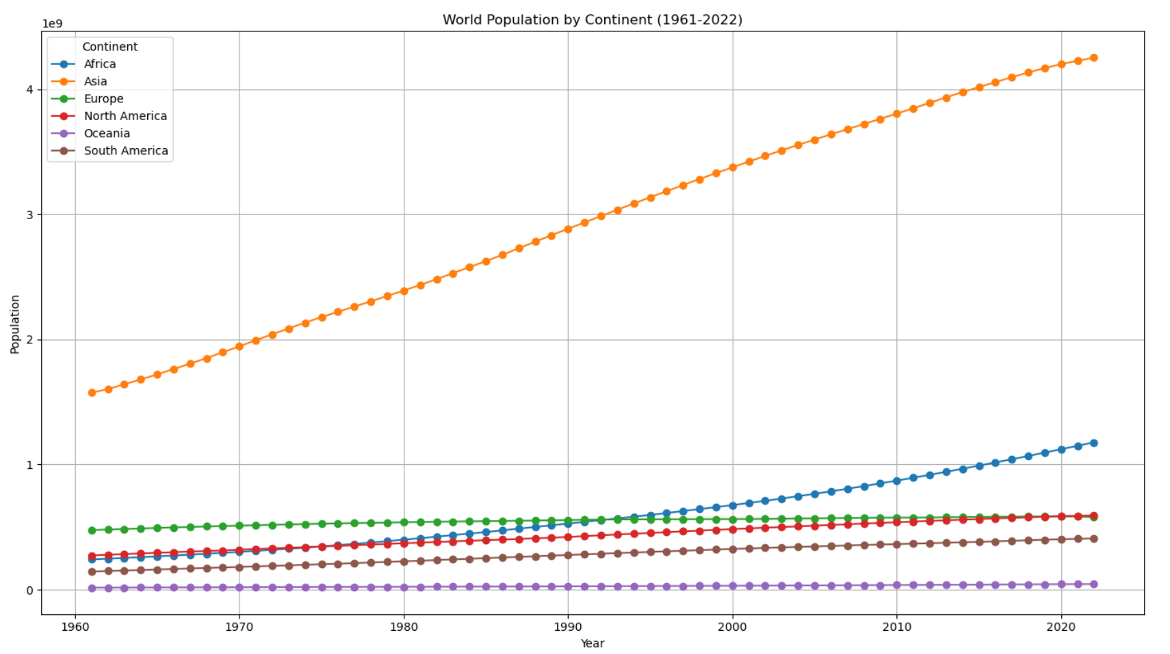

Slide 22
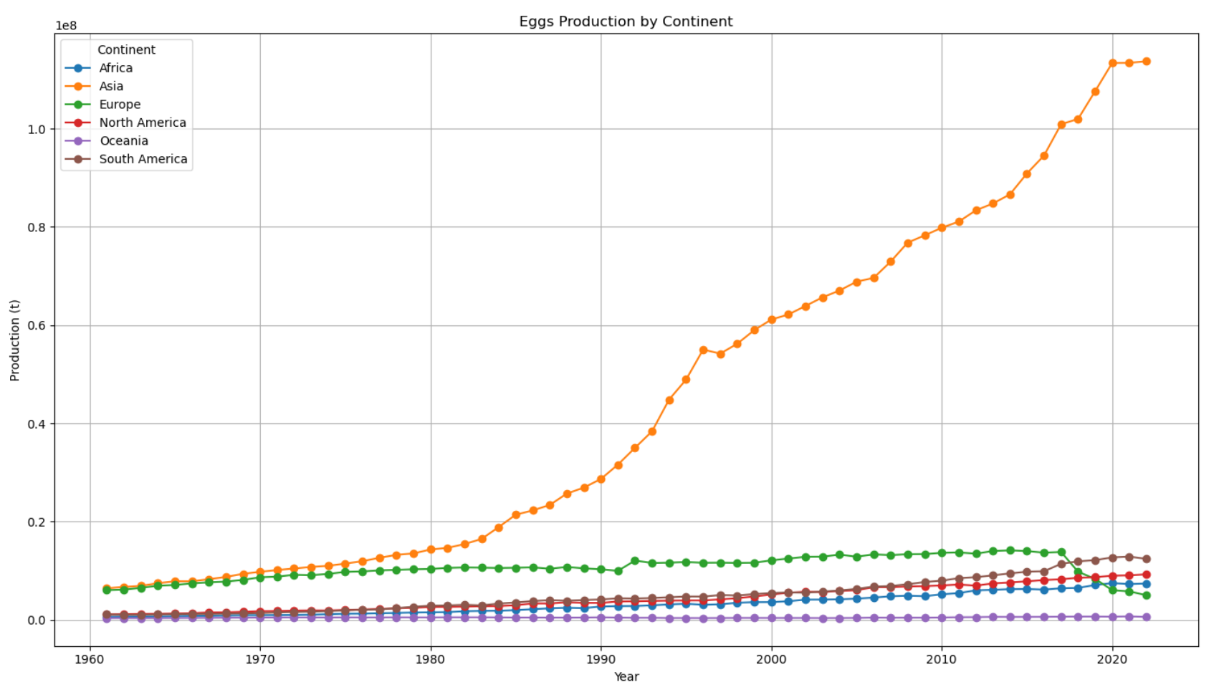

Slide 23
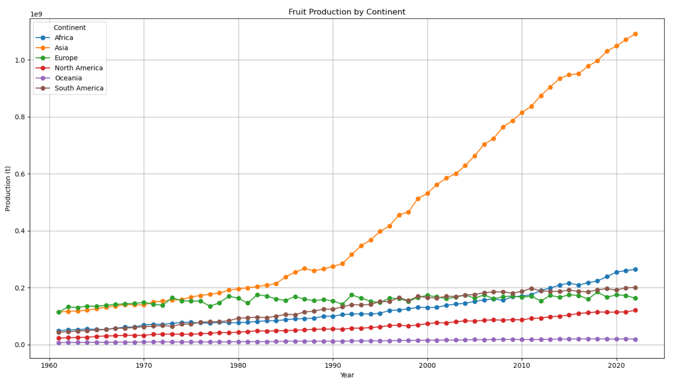

Slide 24
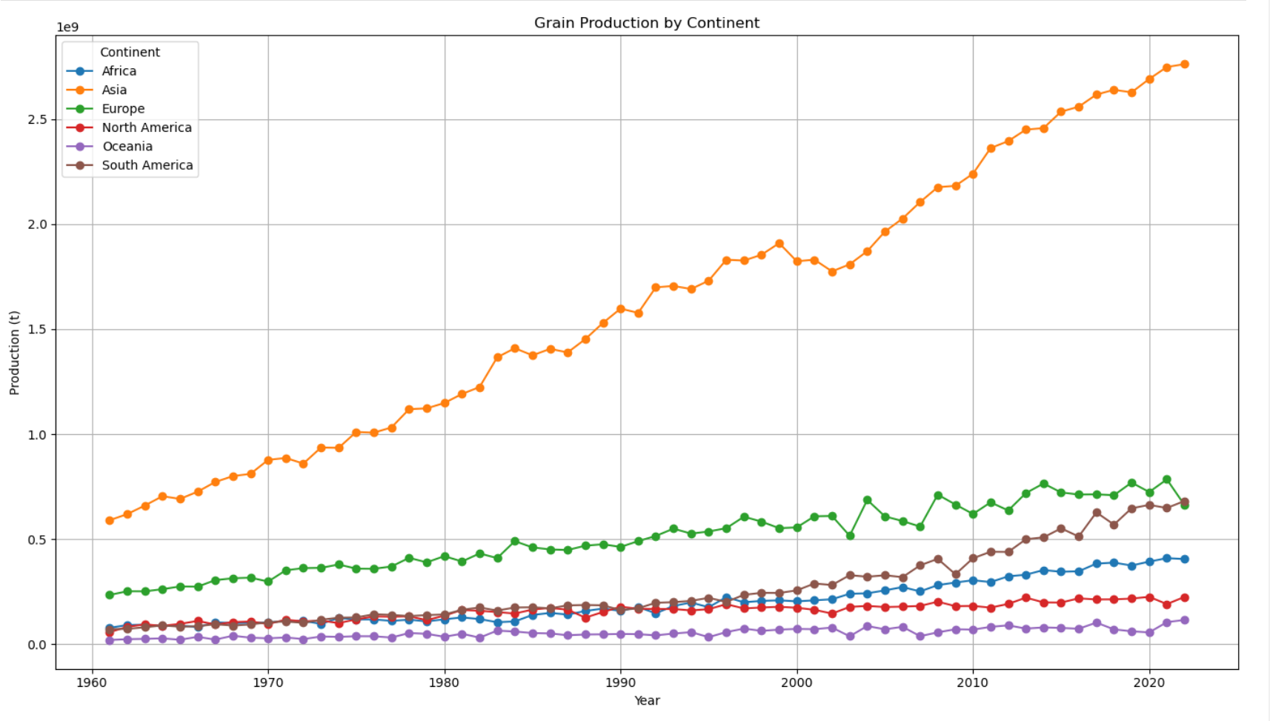

Slide 25
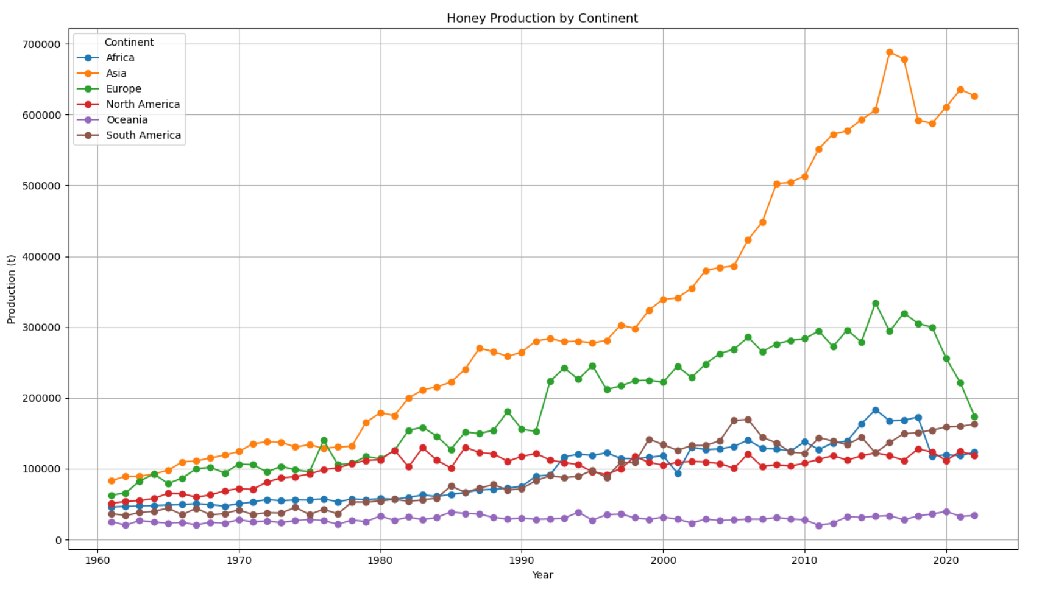

Slide 26
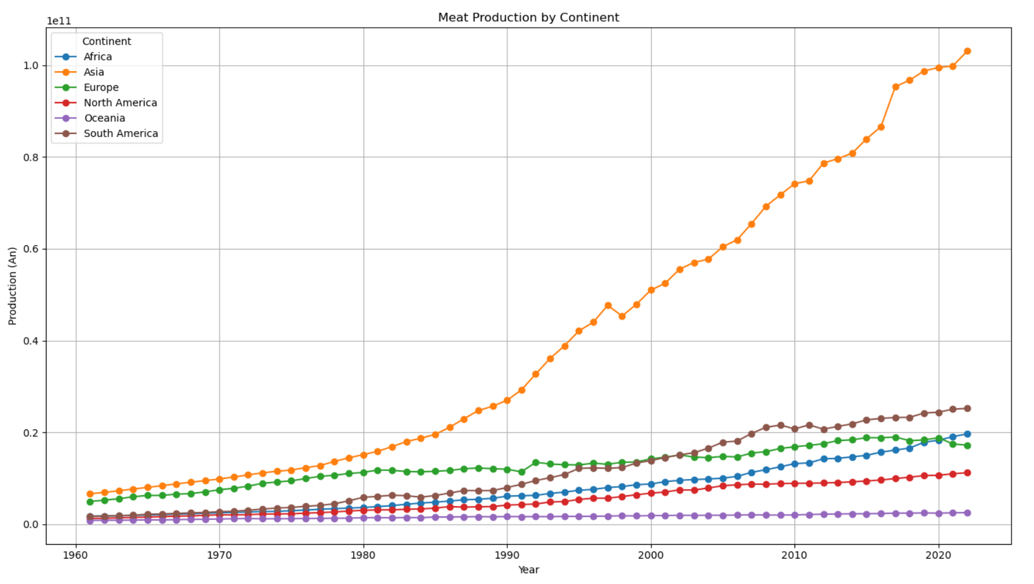

Slide 27
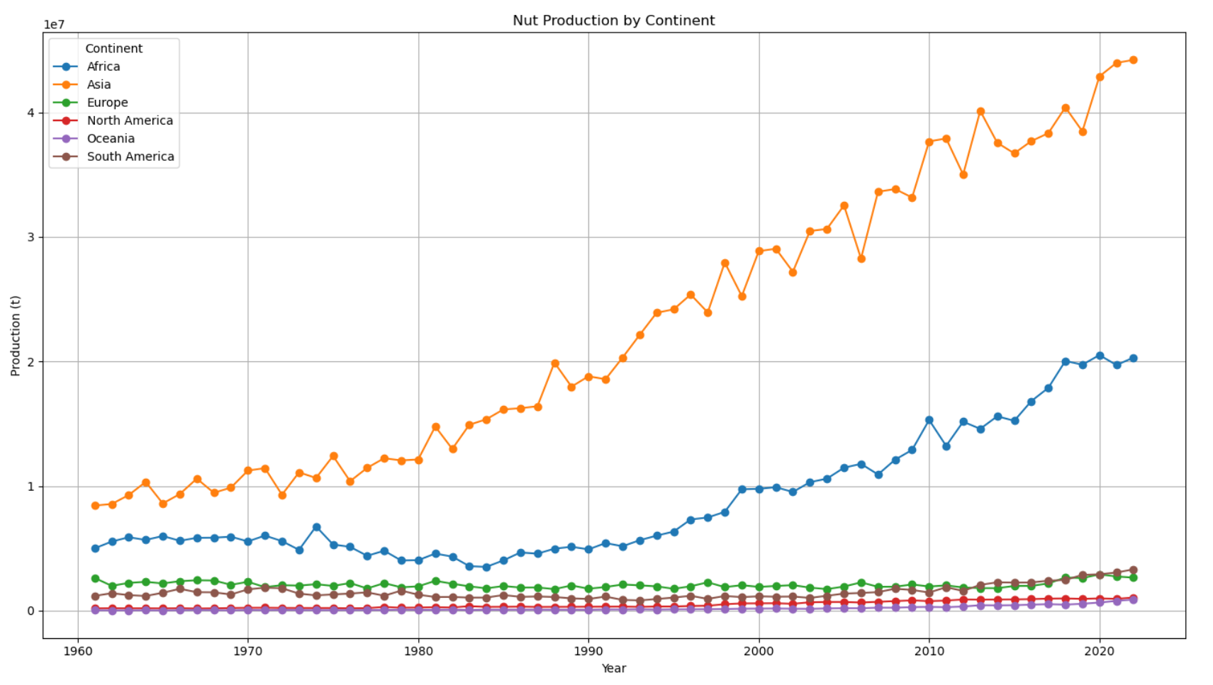

Slide 28
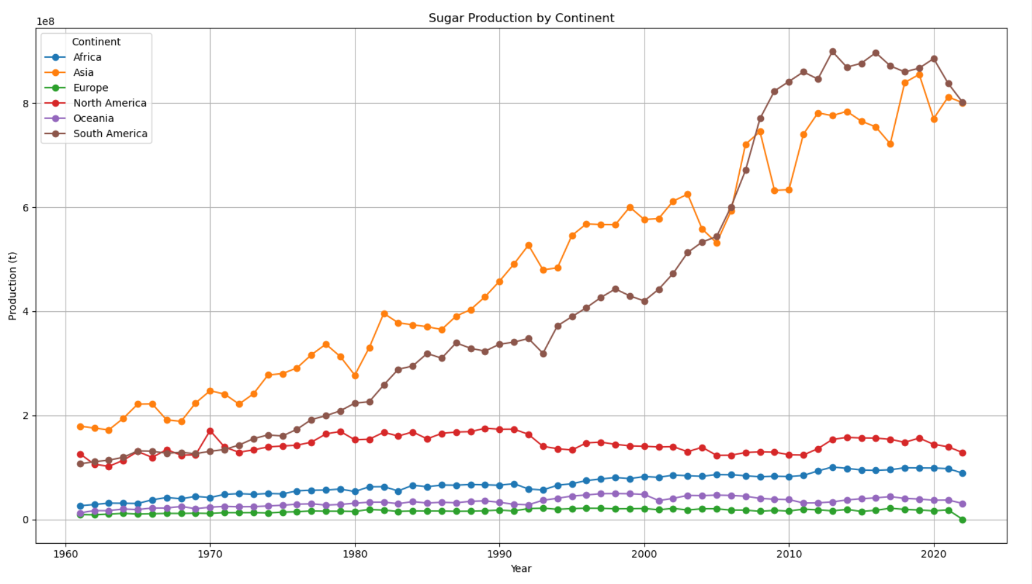

Slide 29
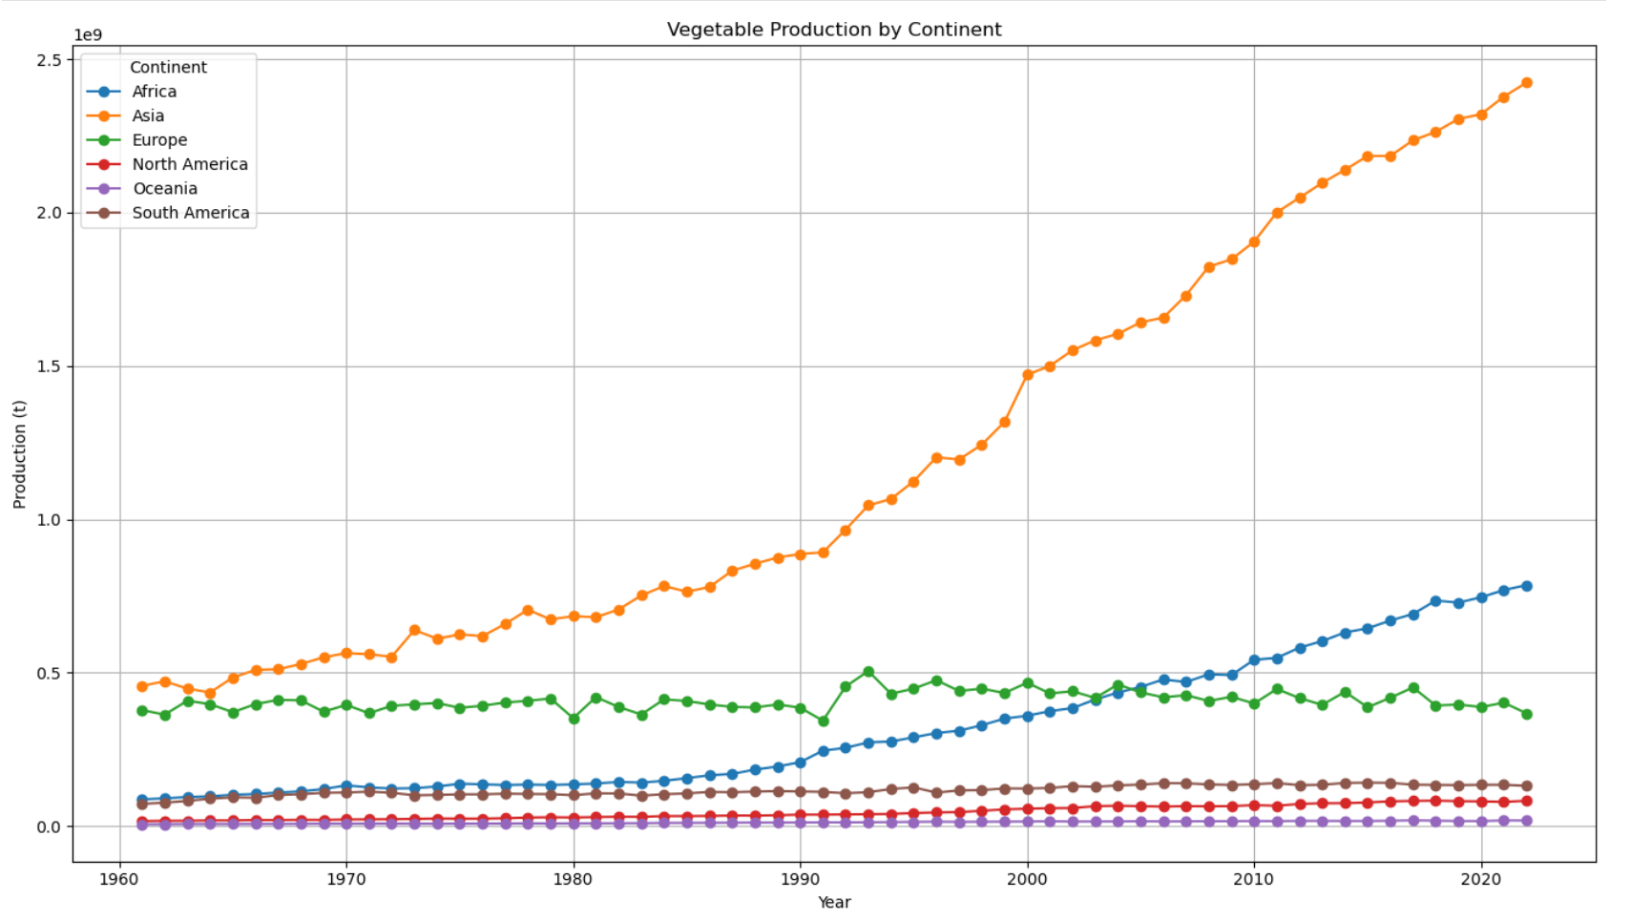

Slide 30
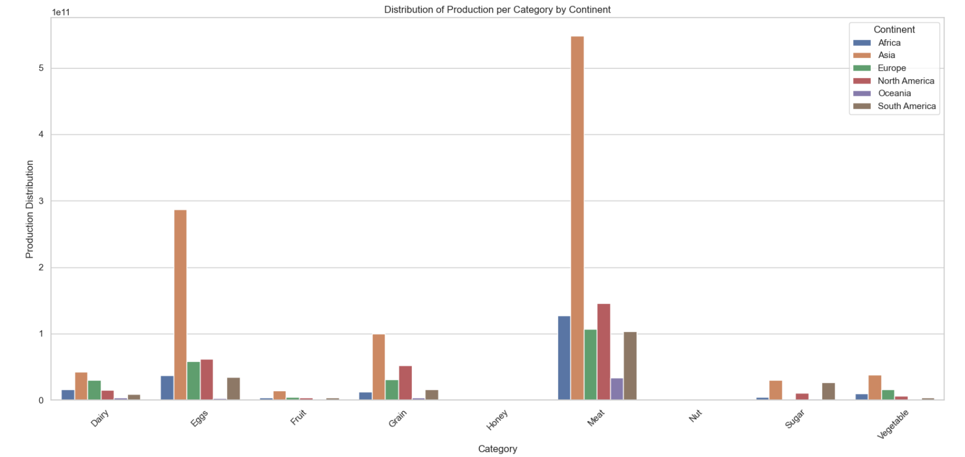
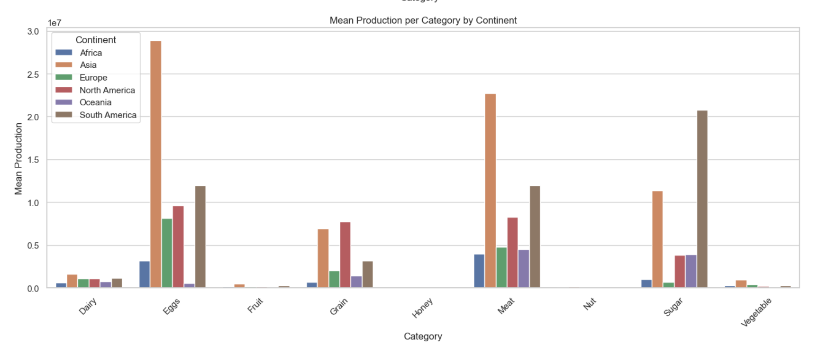
mean
sum

